Slide 1

NSX Provider
info@zekeLabs.com | www.zekeLabs.com | +91 8095465880

Slide 2
Why NSX?
To provide virtualized networking
To provide Security
To enable Multi-cloud Networking
To enable Automation
To provide Networking and Security for containerized workloads
info@zekeLabs.com | www.zekeLabs.com | +91 8095465880

Slide 3
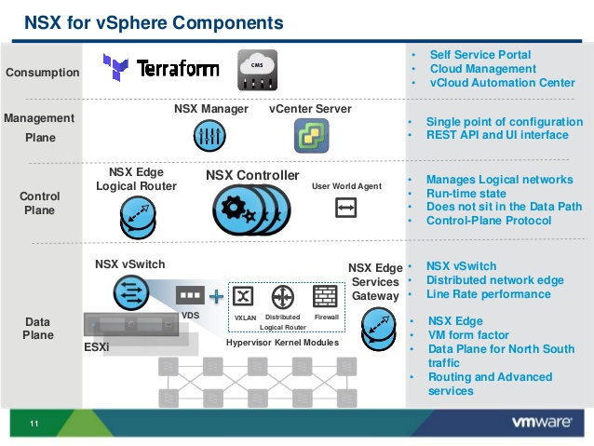
Terraform and NSX
info@zekeLabs.com | www.zekeLabs.com | +91 8095465880

Slide 4
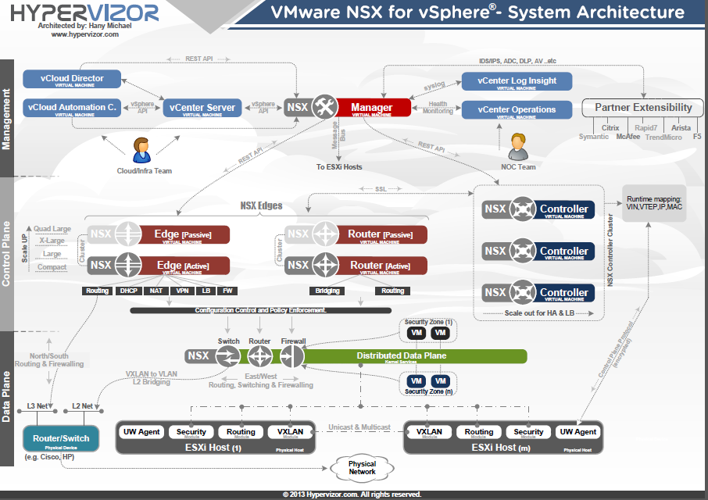
info@zekeLabs.com | www.zekeLabs.com | +91 8095465880

Slide 5
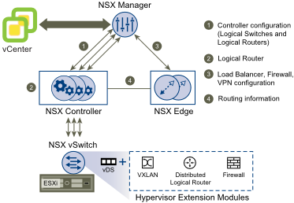
NSX Components
info@zekeLabs.com | www.zekeLabs.com | +91 8095465880

Slide 6
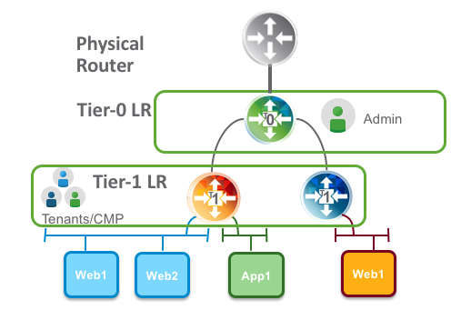
NSX Logical Routers (LR)
info@zekeLabs.com | www.zekeLabs.com | +91 8095465880

Slide 7
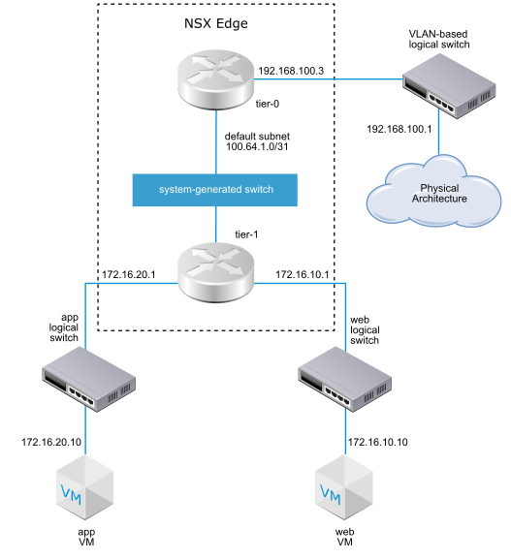
NSX Logical Routers (LR)
info@zekeLabs.com | www.zekeLabs.com | +91 8095465880

Slide 8
Lab
info@zekeLabs.com | www.zekeLabs.com | +91 8095465880

Slide 9
THANK YOU
Let us know how can we help your organization to Upskill the employees to stay updated in the ever-evolving IT Industry.
Get in touch:
www.zekeLabs.com | +91-8095465880 | info@zekeLabs.com
Visit : www.zekeLabs.com for more details

